Slide 1
“Flight”
John Steinbeck
Notes:
Day One
Have students write, “Flight” by John Steinbeck in their notebooks

Slide 2
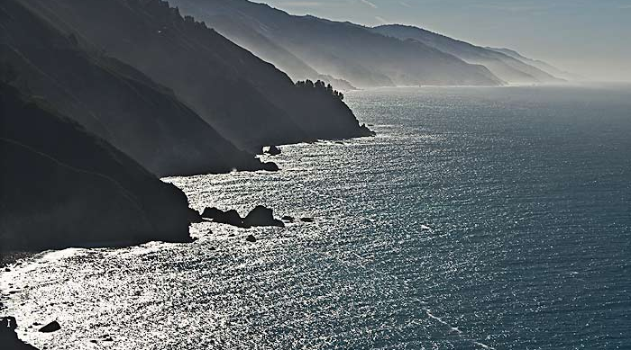
“About fifteen miles below Monterey, on the wild coast, the Torres family had their farm, a few sloping acres above a cliff that dropped to the brown reefs and to the hissing white waters of the ocean.”
Notes:
Day One
Read the first sentence of Steinbeck’s short story aloud to students and have them look at the picture of Big Sur.

Slide 3
Text Opener
When was a time your parents or another adult in your life trusted you and gave you responsibility for something? How did it go?
or
When you make a mistake, are you more likely to admit it quickly and face the consequences or avoid what happened and hope others don’t find out? When was a time you tried to avoid the consequences of your actions?
Notes:
Day One: pre-reading questions: have students choose one to answer in their notebooks. Students should write quietly for 3-4 minutes. When the time is up, have student share in groups of 4 or as a pair share what they wrote. If they didn’t have time to finish, encourage them to elaborate on what they wrote.
Teacher reads “Flight” aloud to students.

Slide 4
Sharing Questions
Write one or two different sharing questions you can discuss with your small group. These are questions you have about the short story from the first reading. They can be about vocabulary, what happened in the story, or anything that left you wondering.
Discuss them thoroughly with your group, and in your notebook write the question someone else asked that interests you the most.
Notes:
Day One or as homework. After discussing questions in small groups, if students are still wondering about their questions, ask for groups to pose these questions to the whole class and get input. These questions can be charted on paper or on the board. If these questions are not easily answered by classmates or you, save them for the second reading of “Flight” or for the Shared Inquiry Discussion.

Slide 5
Guided Notes
Contrasts
C = Where Pepé acts Childishly
A = Where Pepé acts like an Adult
Literary Elements
S = Where the author vividly describes the Setting
How does the author’s description of the setting enhance the story?
Notes:
Day Two: Students will now independently reread “Flight.” They should closely read the text a second time looking for places to mark with the guided notes above. They are looking for both contrasts and setting. Students should mark a C on the text everywhere they see Pepé acting childishly, an A where Pepé acts like an adult, and a S where Steinbeck vividly describes the setting. In the margin by one or two “S” markings on the text, they should answer the question above about how this description enhances the story.
Depending on how quickly students reread or how long the class is, students can get into small groups and discuss where they marked C, A, and S on their texts. This can also be done whole class or in pairs. If the second reading takes all hour, begin tomorrow’s discussion by sharing Guided Notes for about 10 minutes of class.

Slide 6
Shared Inquiry Discussion
Interpretive Question
Does Pepé become a man?
Notes:
Day Three: Either in their notebooks or using “Building Your Answer in a Shared Inquiry Discussion” handout have students write the title and author of the piece and the focus question. Students should then take approximately 10-15 minutes to thoroughly answer the question before the discussion and then find and write or mark a piece of evidence from the text that supports their answers. They should include a page number and a quote or short summary of the passage. When all students are finished preparing their answers, you should facilitate the discussion. Follow up questions in the discussion could include: Does the author want us to feel sorry for Pepé? Why does Mama say, “’Thou? A man? Thou art a peanut.’” Why does Mama say, “’He is nearly a man now?’” What does Mama mean when she tells Emilio “’a boy gets to be a man when a man is needed?’” Why does the author describe Pepé's eyes as “sharp and bright and purposeful?” Why do Mama and Pepe feel he must go to the mountains?

Slide 7
Writing After Discussion
Do you think Pepé was wise or foolish to flee to the mountains? Why do you say so?
or
How do teenagers become adults? What is necessary for this transition to occur?
Notes:
Day Four or for homework: students should choose one of the above questions and write about it. Recommend they return to the text once more for evidence for their position on their question. Three-quarters of a page single-spaced is usually adequate. When students finish, have them share their response with a partner or in a small group.

